Slide 1
TECHNICAL PRESENTATION
CSA0618 – DESIGN AND ANALYSIS OF ALGORITHMS
THE BACKWARD SUBSTITUTION METHOD
DONE BY
S. GRAHAA DIPIKA(192565048)

Slide 2
Understanding recurrence relation:-
What is an recurrence??
A recurrence is an equation or inequality that describes a function in terms of its value on smaller inputs
It arises naturally in recursive paradigms like divide and conquer
Mathematical term:-
T(n) = T(n-1) + n
The need for this:-
To establish the exact computational complexity of an algorithm, we need to convert the recursive relation to non-recursive “closed form” expression
Converting recurrences to standard asymptotic notation(eg:- O(n),O(n^2)) lets us mathematically predict code scalability

Slide 3
SUBSTITUTION PIPELINE
Step 1:-
Iteratively substitute the recursive terms on the right side of the equation using the same recurrence relation formula for (n-1), (n-2), and so on.
Step 2:
Analyze the generated equations without fully simplifying, identifying the general expression at step k.
Step 3:
Set input size to the base case (e.g., T(1)), solve for the iteration variable k, plug it back in, and compute the final closed-form complexity.

Slide 4
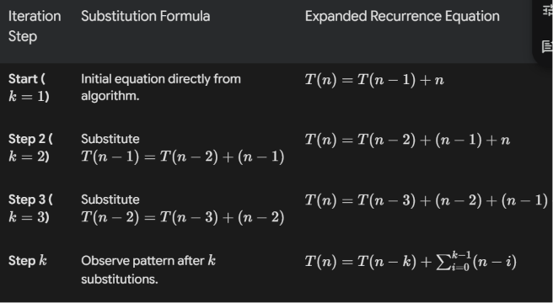
Linear recurrence walkthrough

Slide 5
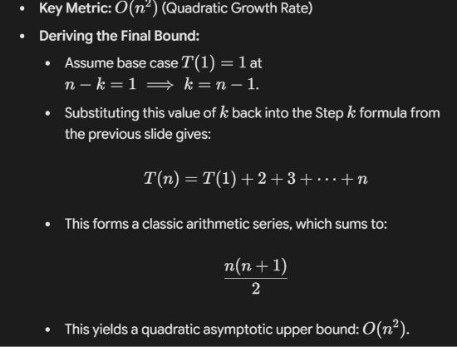
Solving the summation

Slide 6
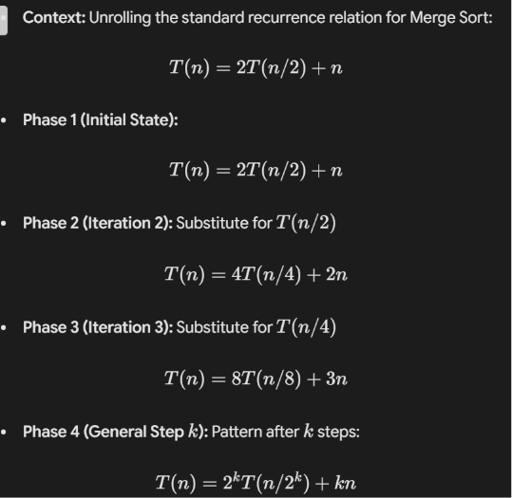
EXAMPLE FOR MERGE SORT:-

Slide 7
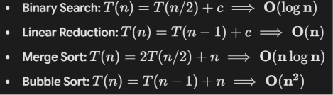
COMPARISON BENCHMARK

Slide 8
THANK YOU

